Slide 1

Efficient inference of stochastic temperature fields with applications to laser powder bed fusion Ti6Al4V Vamsi Subraveti CE6310 Final Project Multiscale Computational Mechanics Laboratory Vanderbilt University
April 28, 2025

Slide 2
Table of contents
Overview of LPBF and problem statement
Experimental data description
Model formulation
Calibration via particle filter
Uncertainty propagation
Extensions, limitations, and future work

Slide 3
Background
Laser powder bed fusion (PBF-LB): metal additive manufacturing technique used to build complex, bespoke parts
Qualification and certification (Q+C) of these parts is an open challenge due to build/test cost
Model-based Q+C spearheading the effort to bring parts into production for aerospace
Process-structure property models need to account for uncertainties at each step in the process + how they aggregate
Problem focus: using melt pool data from experiments, infer underlying thermophysical parameters of a stochastic temperature field model
Process
Structure
Property
Experiment
Experiment
Experiment
In situ melt pool characterization
Flat plate characterization
Single track/ multi track characterization
Serial sectioning
X-ray crystallography on microstructures
Grain size, grain orientation distributions
Texture identification
Various types of fatigue testing
Runout
Cycles to failure
Fractography
Laser
parameters
Layer
thickness
Measurement
error
Powder
composition
Experiment
Data flow
Data flow
Data flow
Model
Model form
error
Model
Melt pool data
Model
Thermophysical
properties
Powder modeling
Thermal field model from laser – analytical, numerical
Heat transfer/fluid flow simulations
Ray tracing simulations
Spatter modeling
Defect modeling
Grain growth and solidification models
Kinetic Monte Carlo, phase field, CA
Texture / orientation models
Alloy composition models
Post-build treatment modeling
Mechanical models (multiscale, PINN, PUCM)
Fracture models
Calibration of thermal model
Stochastic temperature fields

Slide 4

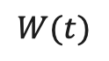
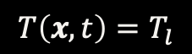
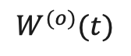

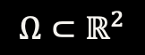

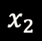
Experimental data, calibration idea
From collaborators at CMU, we have high-quality top-down melt pool width measurements at various processing parameters for Ti6Al4V
We can use the melt pool width (under symmetrical assumptions) to define the liquidus contour in a temperature field
$$T\left(x,t\right)<T_{l}$$
$$T\left(x,t\right)>T_{l}$$
$$W^{(o)}(t)$$
$$T\left(x,t\right)=T_{l}$$
$$W(t)$$
$$x_{2}$$
$$x_{1}$$
$$Ω⊂ℝ^{2}$$

Slide 5
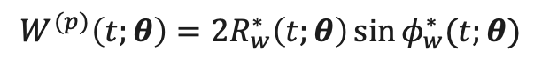
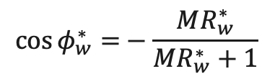
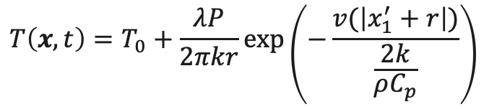
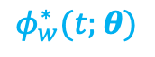
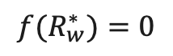
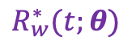
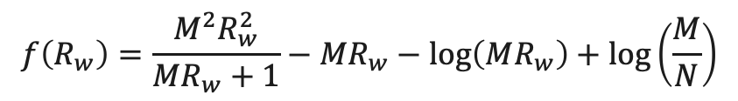
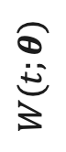
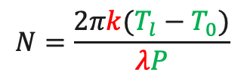
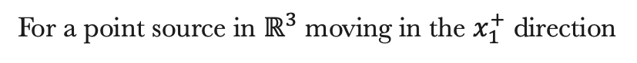
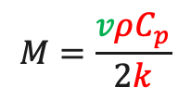
Model description: thermal field, width estimation
The Rosenthal model is a popular analytical heat source model that solves heat conduction for a moving point source
Many simplifications are made (heat source, no fluid flow/phase change), so we will introduce model form error
Pribe et al. 2023 developed a quick numerical approximation of the width in a Rosenthal temperature field
Approximately solves for width by finding roots of a nonlinear function via Brent’s method – a relative of secant method
For a point source in $ℝ^{3}$ moving in the $x_{1}^{+}$ direction
Absorptivity
X-coordinate in moving reference frame
Power
Velocity
Preheat temperature
$$T\left(x,t\right)=T_{0}+\frac{λP}{2πkr}\exp\left(−\frac{v(\left|x_{1}^{′}+r\right|)}{\frac{2k}{ρC_{p}}}\right)$$
Distance from source in moving reference frame
Thermal conductivity
Density
Specific heat
$$M=\frac{vρC_{p}}{2k}$$
$$N=\frac{2πk(T_{l}−T_{0})}{λP}$$
$$f\left(R_{w}\right)=\frac{M^{2}R_{w}^{2}}{MR_{w}+1}−{MR}_{w}−\log\left(MR_{w}\right)+\log\left(\frac{M}{N}\right)$$
$$R_{w}^{∗}(t;θ)$$
$$\cos{φ_{w}^{∗}=}−\frac{MR_{w}^{∗}}{MR_{w}^{∗}+1}$$
Scan vector
$${f(R}_{w}^{∗})=0$$
$$W(t;θ)$$
$$φ_{w}^{∗}(t;θ)$$
$$W^{(p)}\left(t;θ\right)=2R_{w}^{∗}\left(t;θ\right)\sin{φ_{w}^{∗}(t;θ)}$$

Slide 6
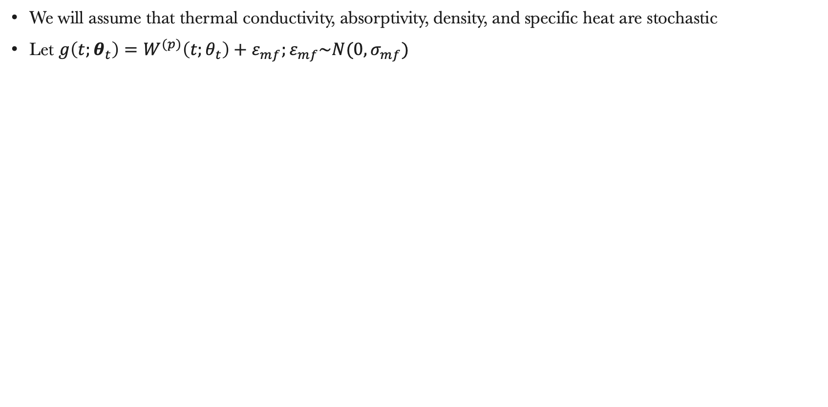
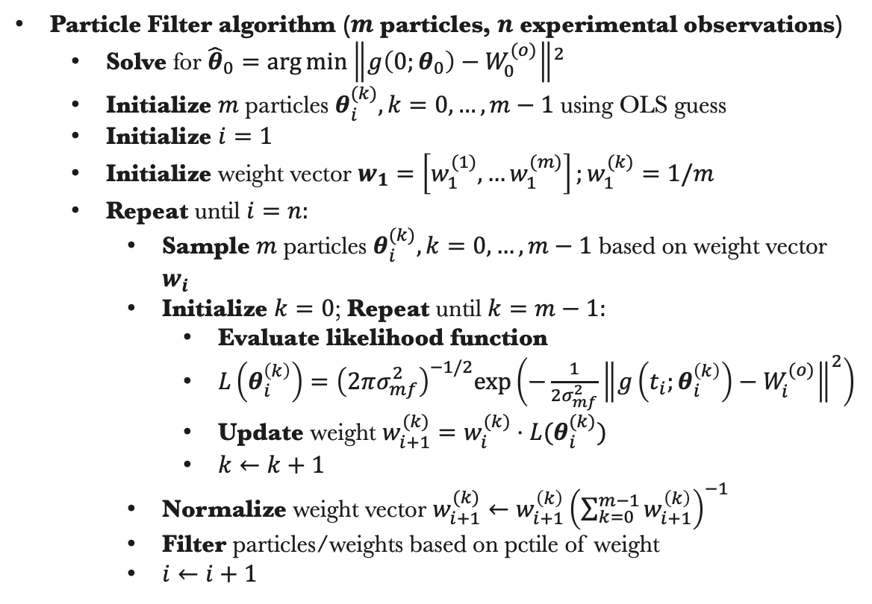
Model description: particle filter
We will assume that thermal conductivity, absorptivity, density, and specific heat are stochastic
Let $g\left(t;θ_{t}\right)=W^{(p)}\left(t;θ_{t}\right)+ε_{mf};ε_{mf}\sim N(0,σ_{mf})$
Particle Filter algorithm ($m$ particles, $n$ experimental observations)
Solve for ${\hat{θ}}_{0}={\arg{\min\left\|g\left(0;θ_{0}\right)−W_{0}^{(o)}\right\|}}^{2}$
Initialize $m$ particles $θ_{i}^{(k)},k=0,…,m−1$ using OLS guess
Initialize $i=1$
Initialize weight vector $w_{1}=\left[w_{1}^{(1)},…w_{1}^{(m)}\right];w_{1}^{(k)}=1/m$
Repeat until $i=n:$
Sample $m$ particles $θ_{i}^{(k)},k=0,…,m−1$ based on weight vector $w_{i}$
Initialize $k=0$; Repeat until $k=m−1:$
Evaluate likelihood function
$L\left(θ_{i}^{\left(k\right)}\right)={\left(2πσ_{mf}^{2}\right)}^{−1/2}exp\left(−\frac{1}{2σ_{mf}^{2}}{\left\|g\left(t_{i};θ_{i}^{\left(k\right)}\right)−W_{i}^{(o)}\right\|}^{2}\right)$
Update weight $w_{i+1}^{(k)}=w_{i}^{(k)}⋅L(θ_{i}^{(k)})$
$k←k+1$
Normalize weight vector $w_{i+1}^{(k)}←w_{i+1}^{\left(k\right)}{\left(\sum_{k=0}^{m−1}{w_{i+1}^{\left(k\right)}}\right)}^{−1}$
Filter particles/weights based on pctile of weight
$i←i+1$
Initialization of particles around the OLS solution at t=0.

Slide 7
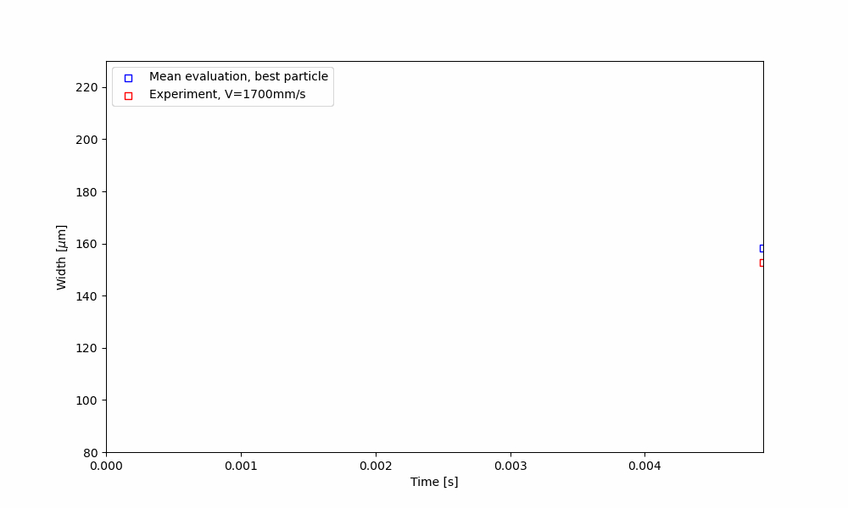
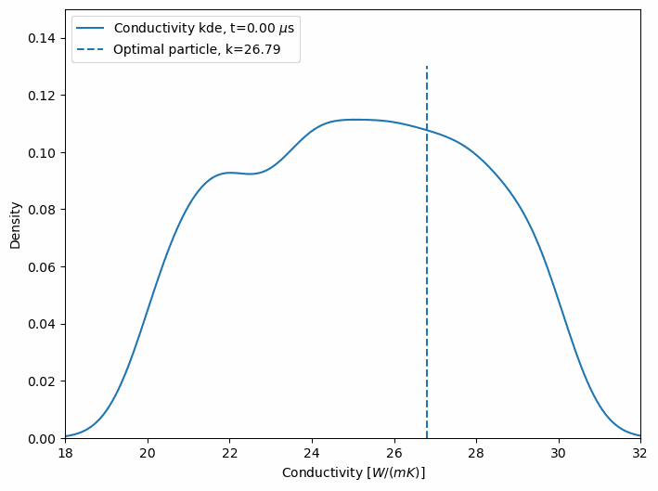
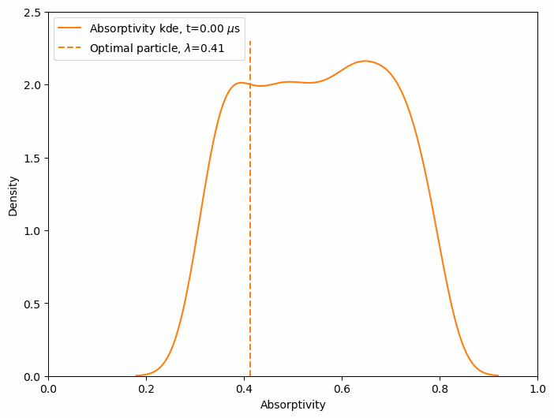
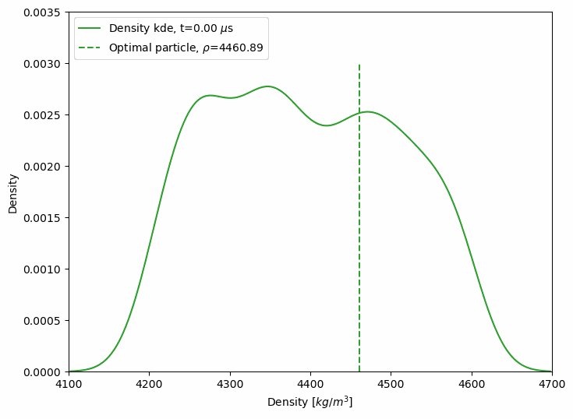
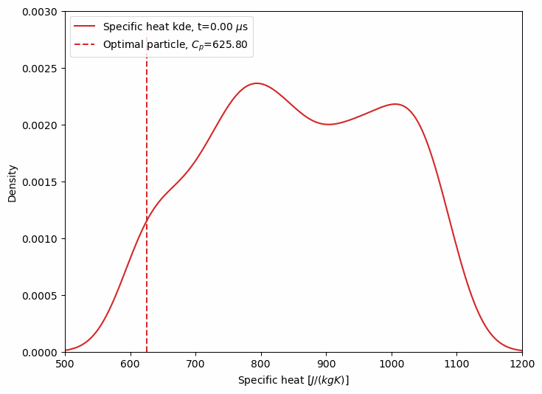
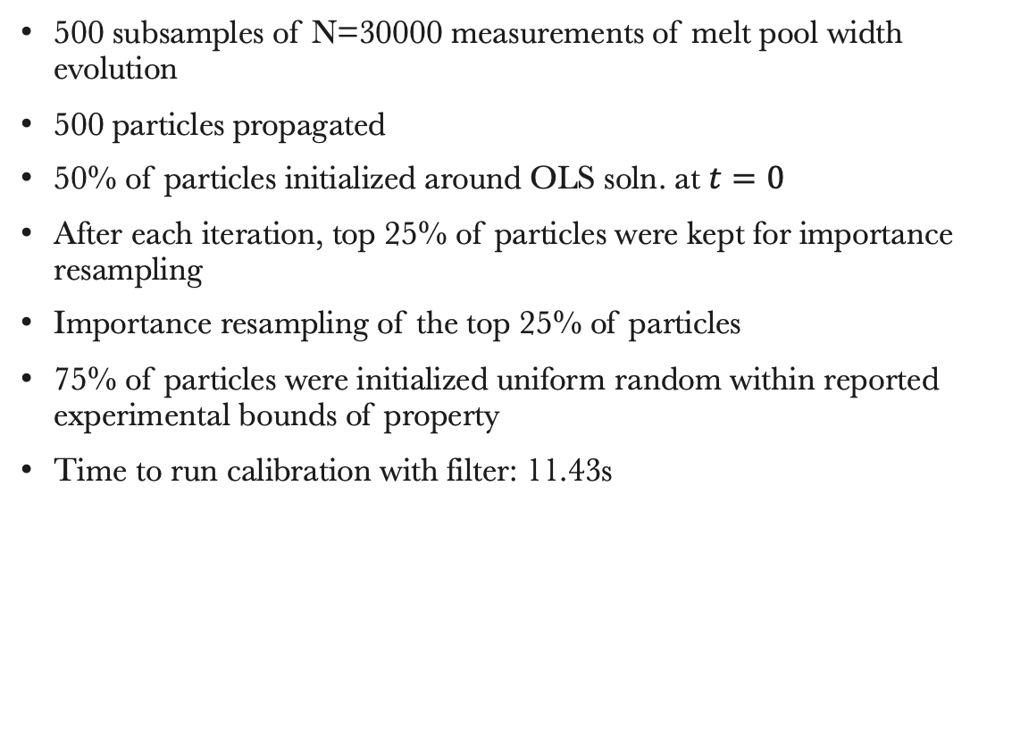
Particle filter results
500 subsamples of N=30000 measurements of melt pool width evolution
500 particles propagated
50% of particles initialized around OLS soln. at $t=0$
After each iteration, top 25% of particles were kept for importance resampling
Importance resampling of the top 25% of particles
75% of particles were initialized uniform random within reported experimental bounds of property
Time to run calibration with filter: 11.43s

Slide 8
Propagation of parameter, model form uncertainty
Extracting optimal particle at each timestep, executing width model n=20 times to obtain variance in width estimation
Model mean, model variance extracted at each of 500 subsampled timesteps
Time to run inference with n=20: 9.49s
Model shows good response to large fluctuations in width
Variance increases with smaller fluctuations, possibly due to many near-optimal particles
Filter would select against non-optimal particles in extreme fluctuation cases
Many near-optimal particles could result in less accurate estimation of width

Slide 9
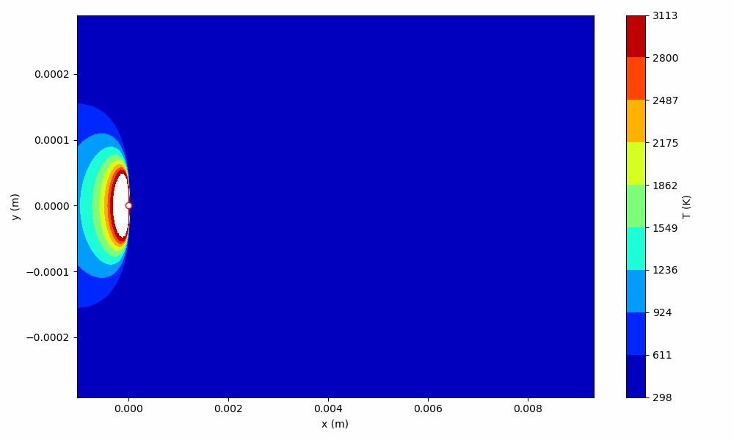
Inferred stochastic temperature field

Slide 10
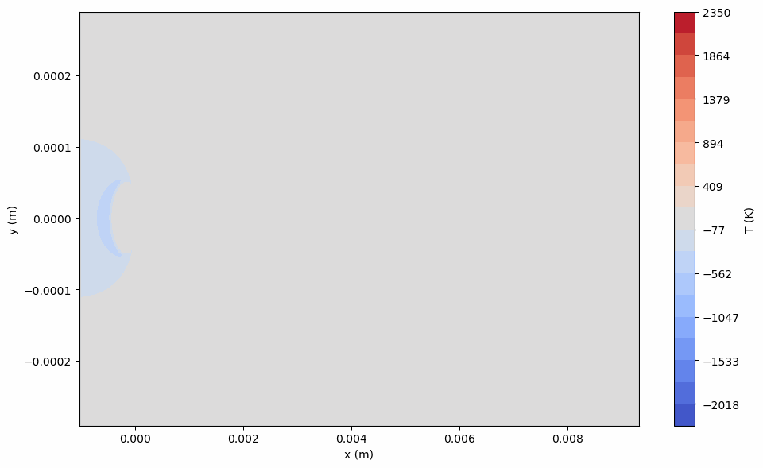
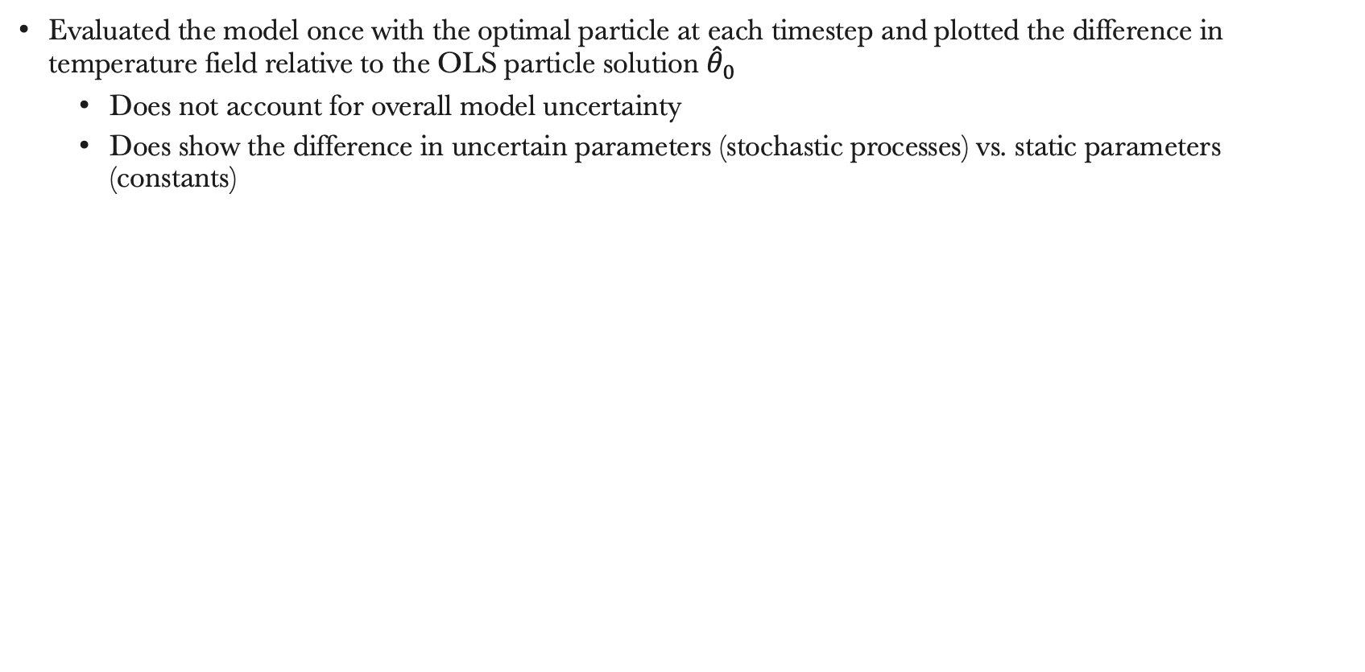
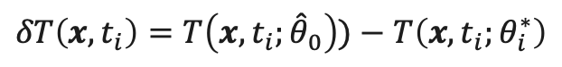
Difference in temperature fields, optimal particle
Evaluated the model once with the optimal particle at each timestep and plotted the difference in temperature field relative to the OLS particle solution ${\hat{θ}}_{0}$
Does not account for overall model uncertainty
Does show the difference in uncertain parameters (stochastic processes) vs. static parameters (constants)
$$δT\left(x,t_{i}\right)=T\left(x,t_{i};{\hat{θ}}_{0}\right))−T\left(x,t_{i};θ_{i}^{∗}\right)$$

Slide 11
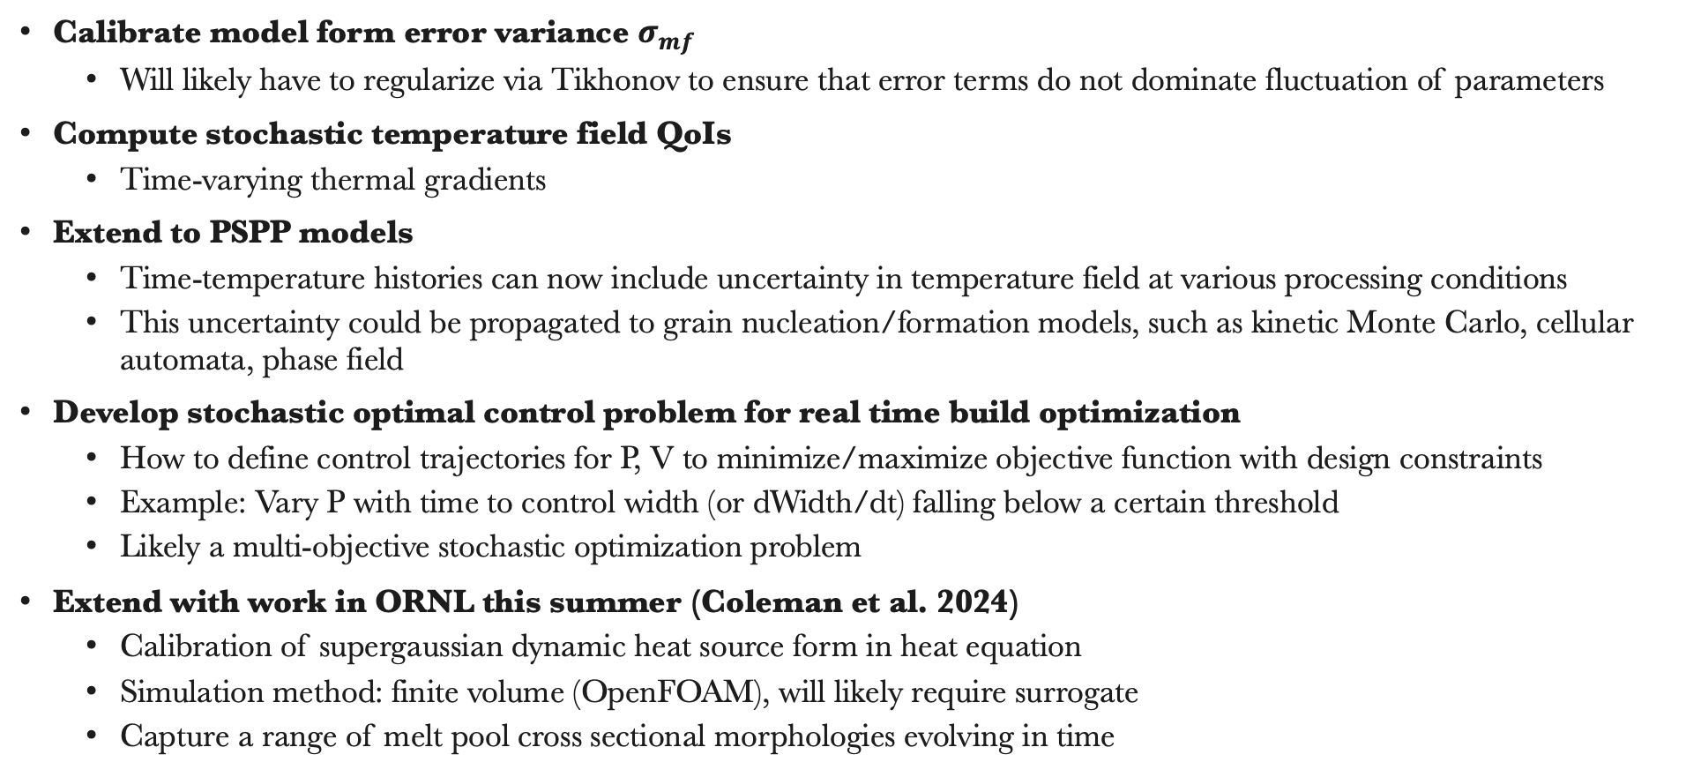
Future work
Calibrate model form error variance $σ_{mf}$
Will likely have to regularize via Tikhonov to ensure that error terms do not dominate fluctuation of parameters
Compute stochastic temperature field QoIs
Time-varying thermal gradients
Extend to PSPP models
Time-temperature histories can now include uncertainty in temperature field at various processing conditions
This uncertainty could be propagated to grain nucleation/formation models, such as kinetic Monte Carlo, cellular automata, phase field
Develop stochastic optimal control problem for real time build optimization
How to define control trajectories for P, V to minimize/maximize objective function with design constraints
Example: Vary P with time to control width (or dWidth/dt) falling below a certain threshold
Likely a multi-objective stochastic optimization problem
Extend with work in ORNL this summer (Coleman et al. 2024)
Calibration of supergaussian dynamic heat source form in heat equation
Simulation method: finite volume (OpenFOAM), will likely require surrogate
Capture a range of melt pool cross sectional morphologies evolving in time

